Slide 1
Welcome

Slide 2


Slide 4

Client
Http Request
Http Response

Slide 5

UI/UX

Slide 6
Definition ?!

Slide 7


Slide 8


Slide 9
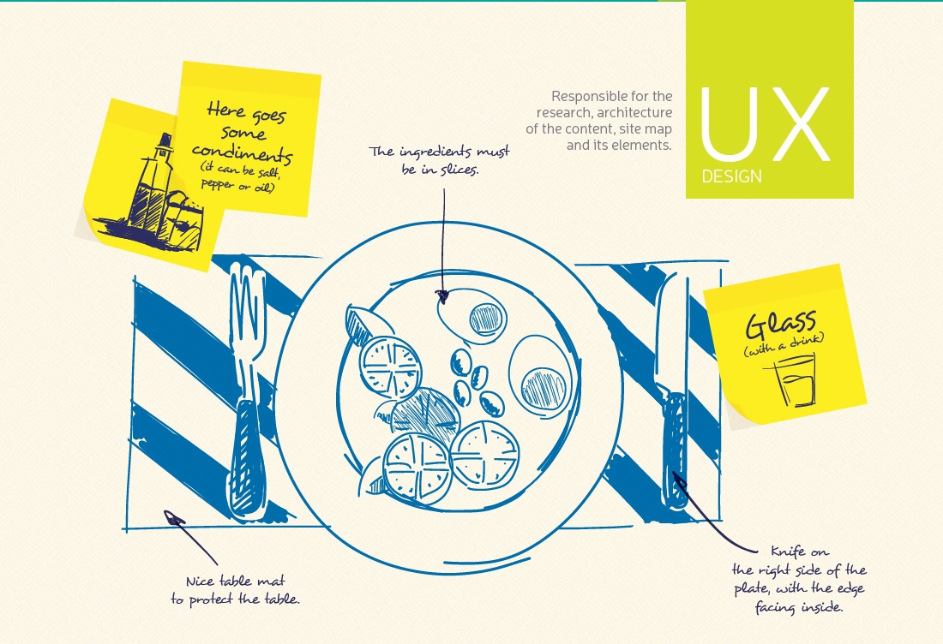

Slide 10


Slide 11


Slide 12


Slide 13


Slide 14
Cool colors
Warm colors

Slide 15
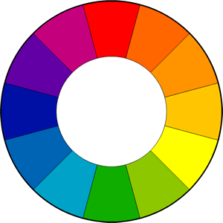
Complementary

Slide 16
Analogous

Slide 17
Triadic

Slide 18
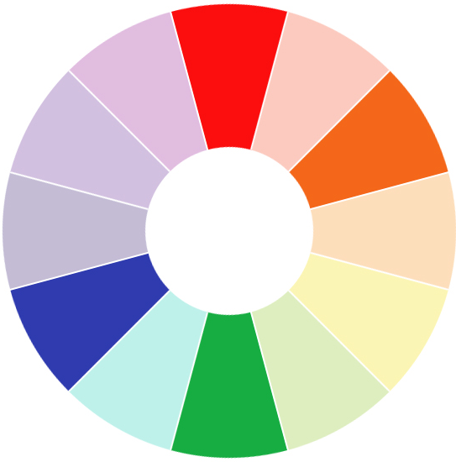
Tetradic

Slide 19
Hello World

Slide 20


Slide 21
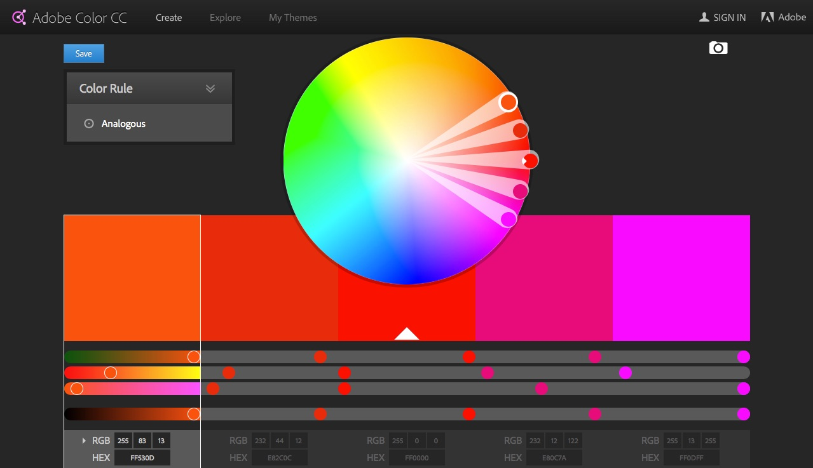

Slide 22
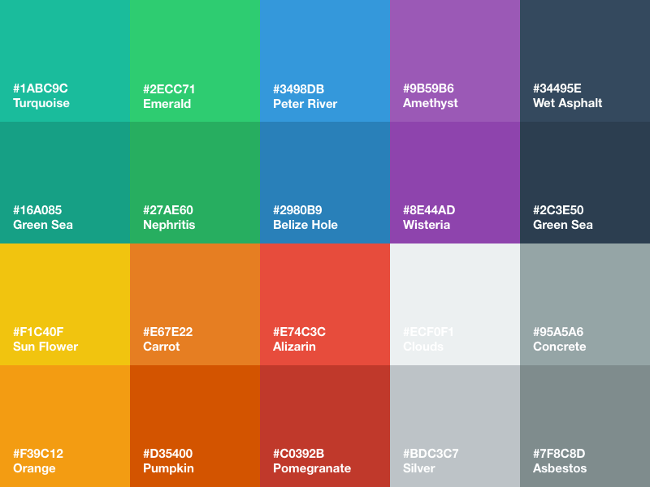

Slide 23
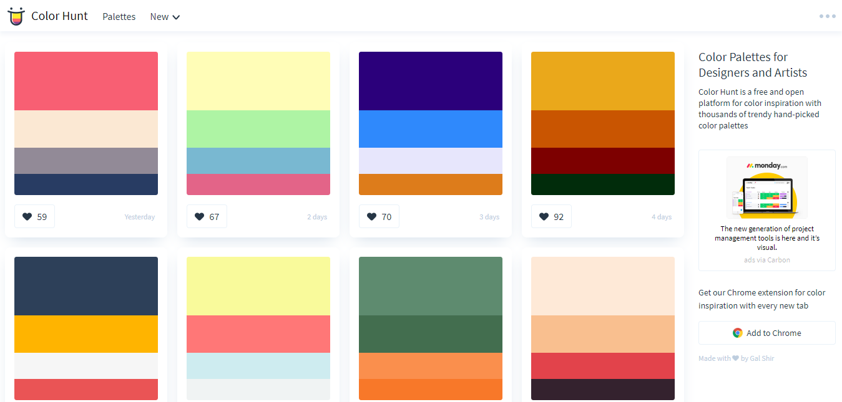

Slide 24
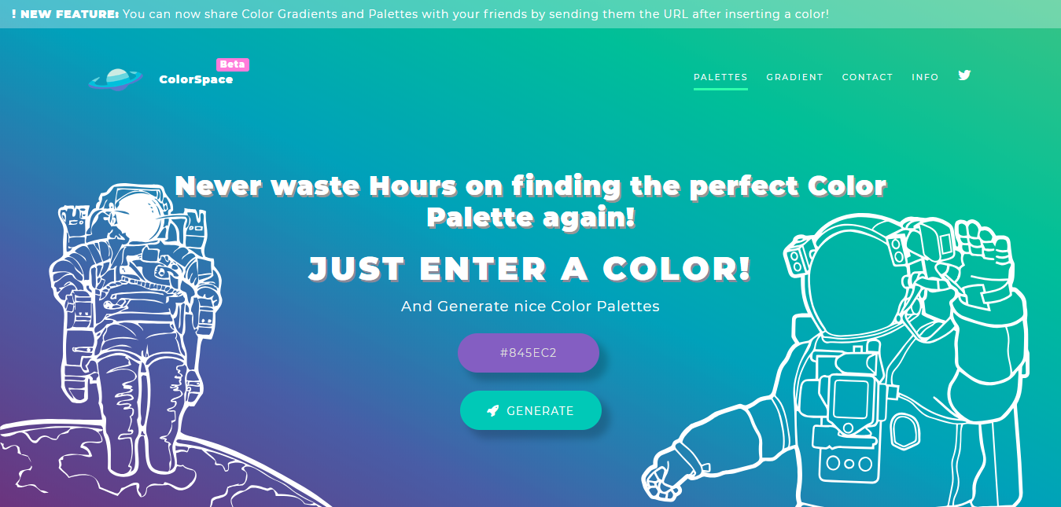

Slide 25
Typography

Slide 26
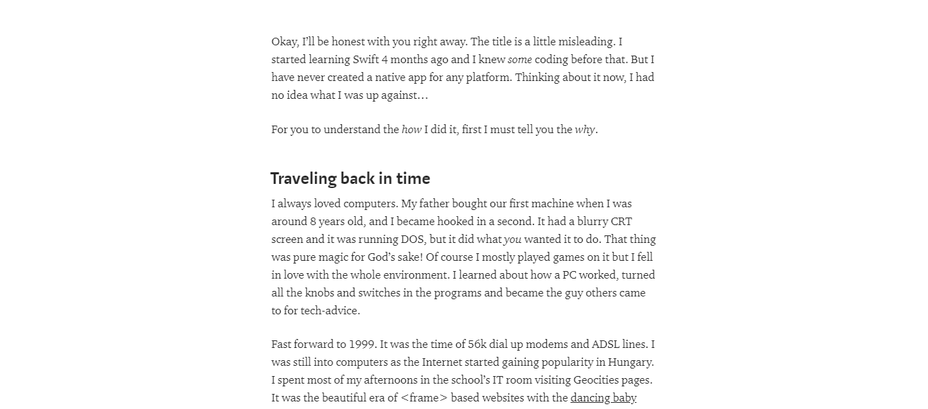
Body Fonts

Slide 27
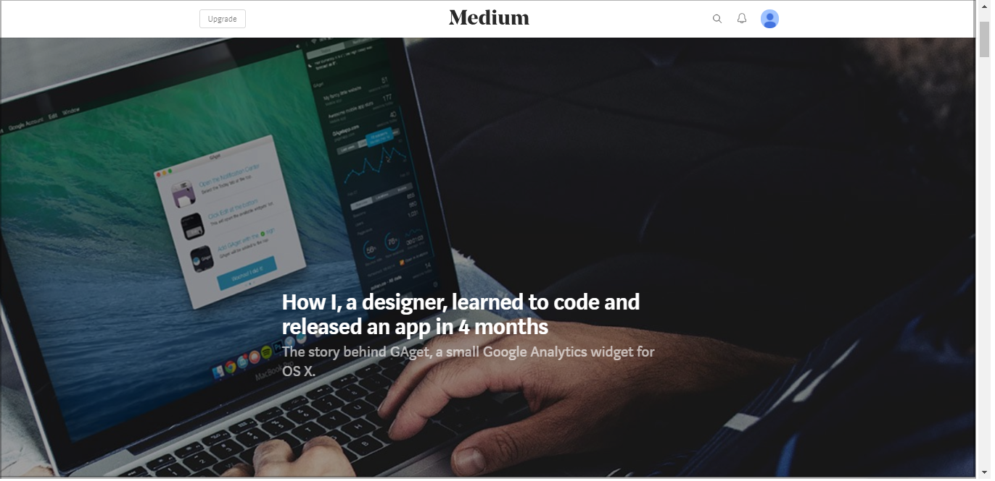
Headers

Slide 28

HTML
Hyper Text Markup Language

Slide 29


CSS
Cascading Style Sheets

Slide 30
